Slide 1
Difference in Difference

Slide 2
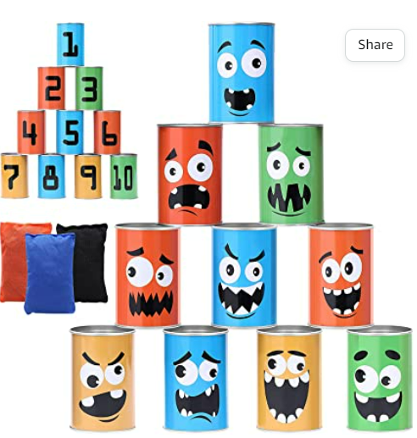
Bean Bag Toss: A game to explore difference in difference
How many can you knock down?
Notes:
Explain to students that they will be playing a tabletop bean bag toss game,where there is a stack of tin cans and the students must stand behind a line and toss a bean bag into the cans to try to knock down as many as they can. Let them know that we will be using this activity to investigate a statistical concept, but that we will discuss the specifics later.

Slide 3
Rules of the game:
The class will be divided into two teams
Each team should:
Come up with a team name and record it on your index card
Team members take turns based on the number on index card
Throw bean bag to see how many cans each member can knock down
Record that number on their index card
When instructed, plot data on graph.
Link to the Data table and graph for activity

Slide 4
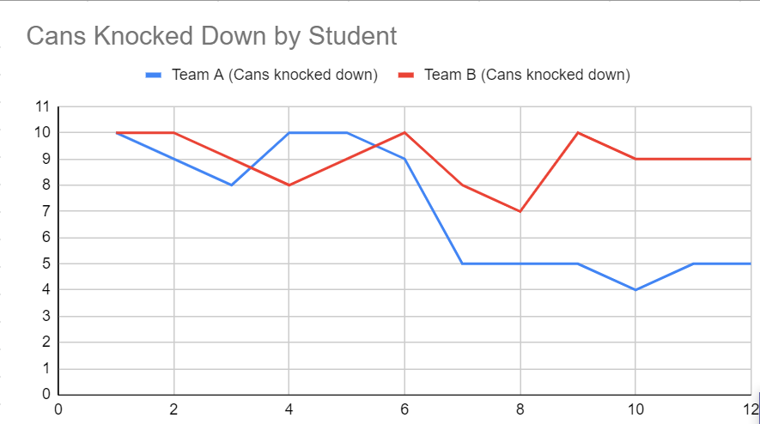
Sample Graph
# of Cans Knocked Down
Student
Notes:
Questions to lead discussion:
Why do we use line graphs?
What information do they help us visualize?
Hopefully students know that they help us see trends in our data. Then ask “What trends do we notice about this data? Who won? Was one team winning the entire time? What happened here? (pointing to the dip in Team A’s performance in round 2) Why do you think that happened?”
Instructors can then let students in on the fact that the cans were swapped out for weighted cans. The dip in our data shows the point where something in the environment changed

Slide 5
What is Difference in Difference?
Difference in difference is a statistical technique used in research
It attempts to mimic an experimental research design by studying the differential effect of a treatment group versus a control group in a natural experiment
It calculates the effect of an explanatory variable on an outcome (response variable)
It does this by comparing the average change over time in the outcome variable for the treatment group to the average change over time for the control group.
If we see a significant difference in difference in our data that is a clue that something in the environment changed at that point in time and it is worth exploring
Notes:
After explaining the concept have students either look at the graph that they created or the sample graph provided and identify the following:
Treatment group - group A
Control group - group B
Explanatory variable - student throwing
Outcome or response variable - # bags knocked down

